Slide 1
COVID-19 PROJECT Data Analysis

Slide 2
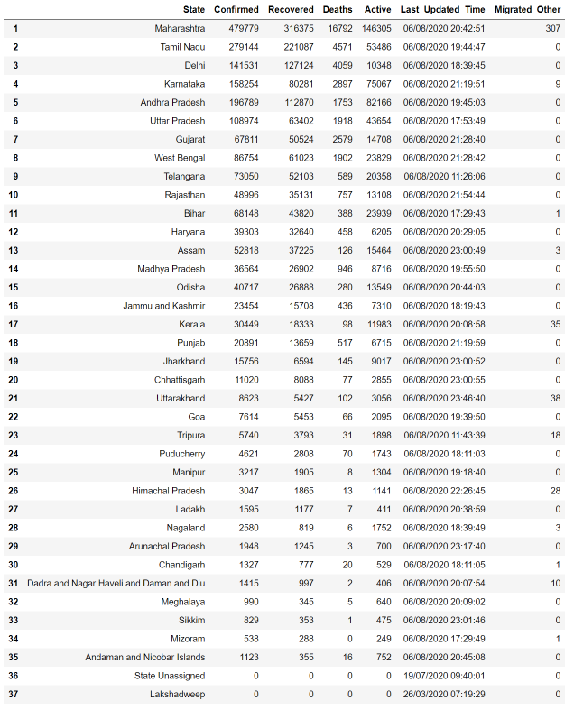
State wise covid-19 cases.

Slide 3
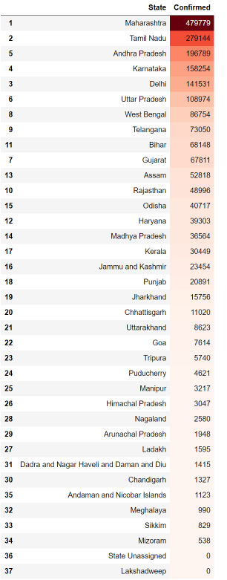
States with highest number of Confirmed Cases

Slide 4
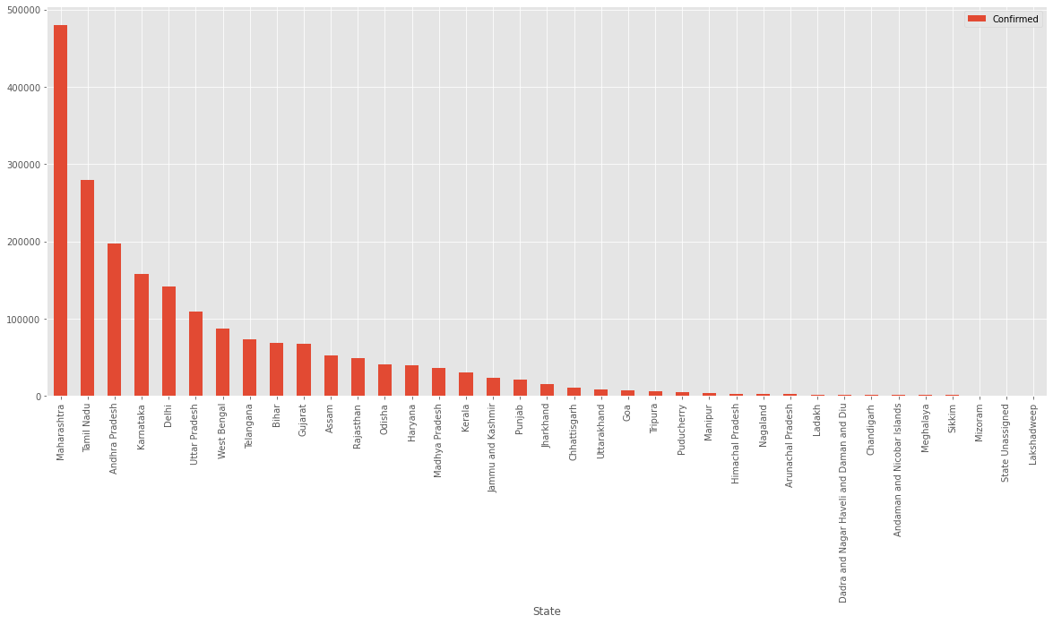

Slide 5
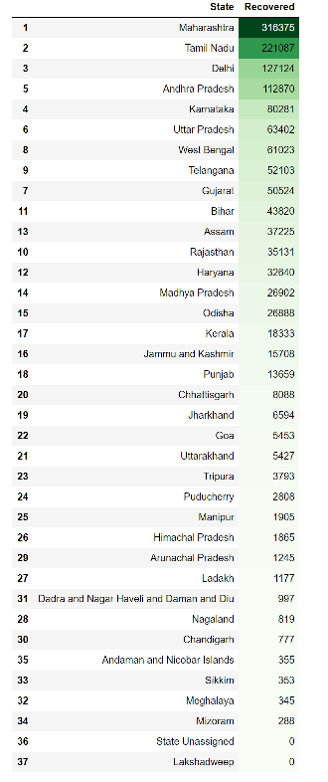
States with highest number of Recovered Patients

Slide 6


Slide 7
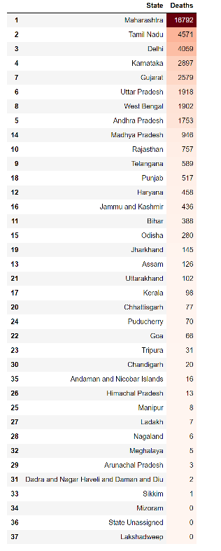
States with highest number of Covid19 Deaths

Slide 8
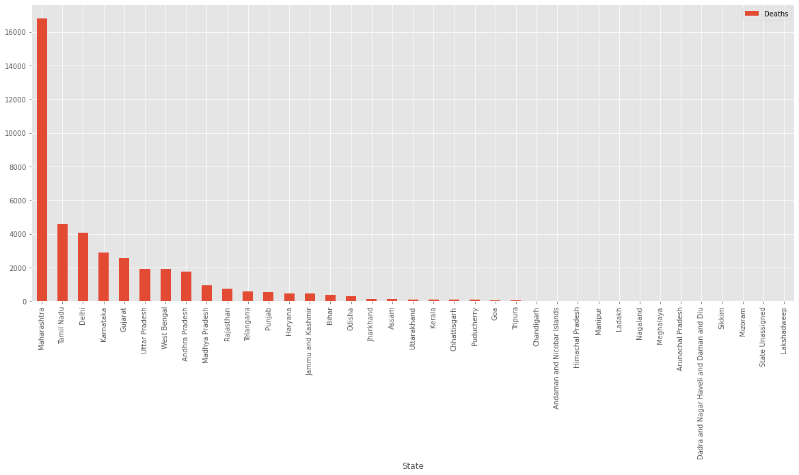

Slide 9
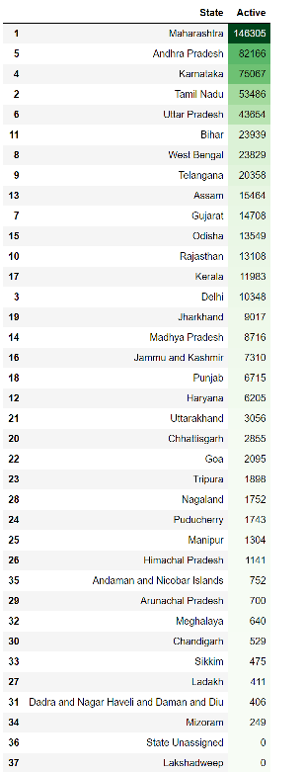
States with highest number of Covid19 Active Cases

Slide 10
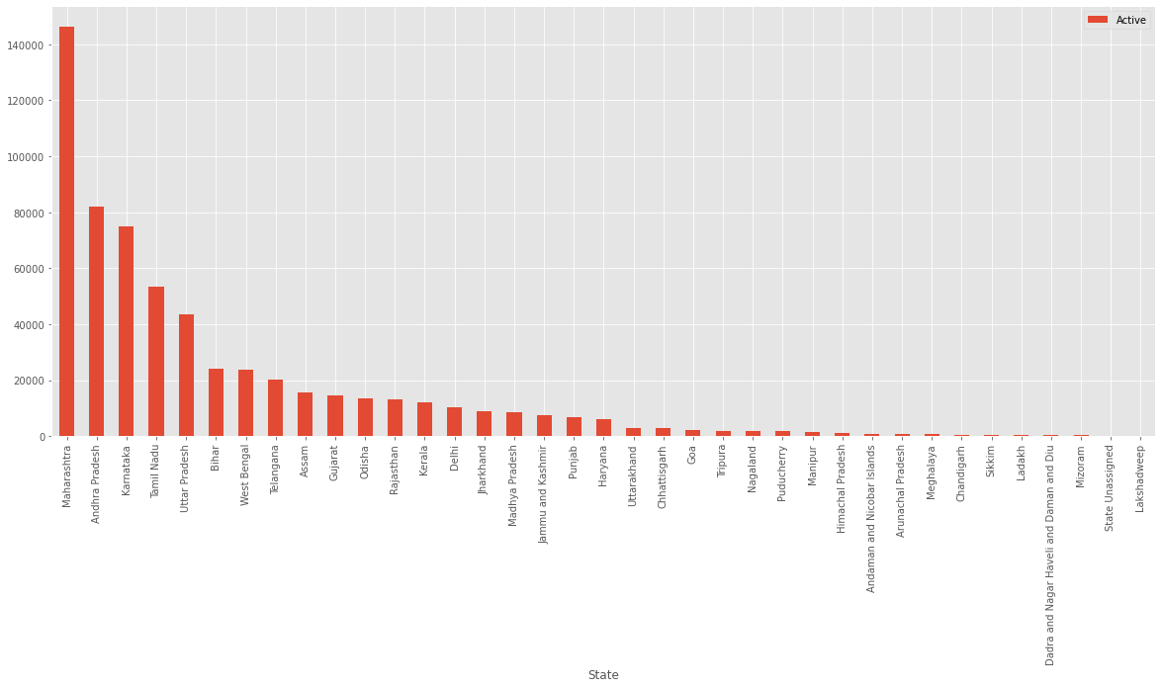

Slide 11
Total number of Confirmed Cases in India till 6August 2020
2025409
Total number of Recovered Patients in India till 6August 2020
1377384
Total number of Covid19 Deaths in India till 6August 2020
41638
Total number of Active Cases in India till 6August 2020
605933

Slide 12
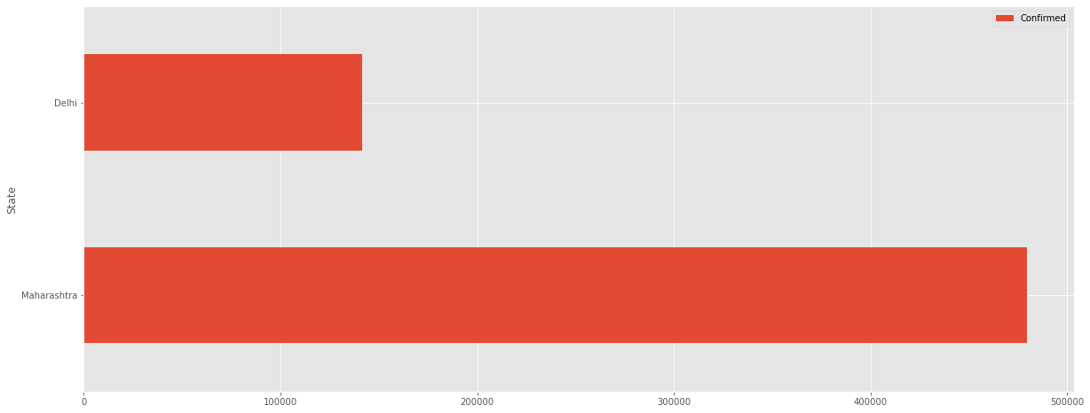
Maharashtra and Delhi - Confirmed Cases

Slide 13
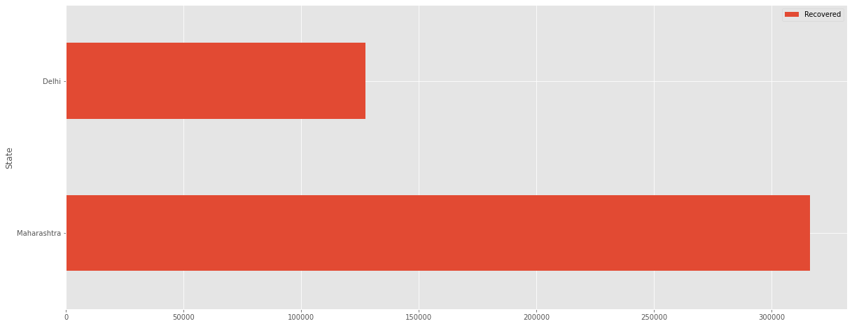
Maharashtra and Delhi – Recovered Patients

Slide 14
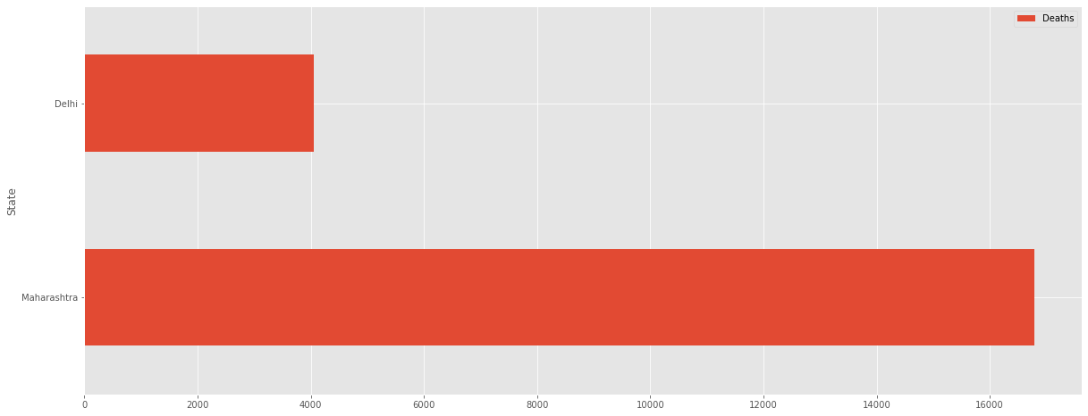
Maharashtra and Delhi – Covid19 Deaths

Slide 15
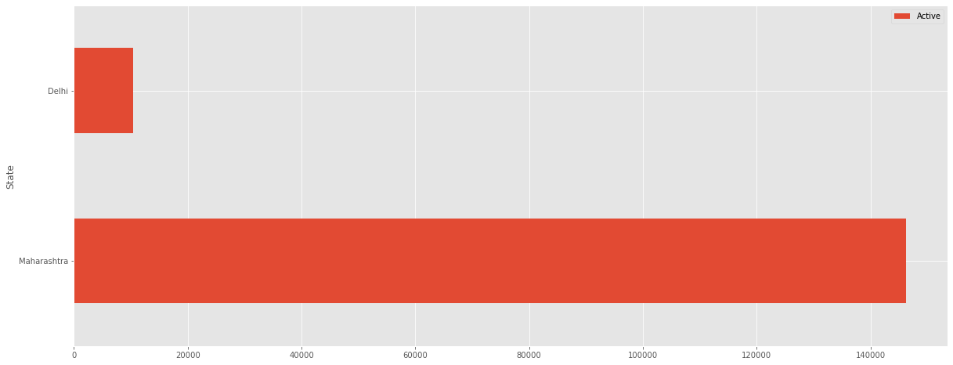
Maharashtra and Delhi – Active Cases

Slide 16
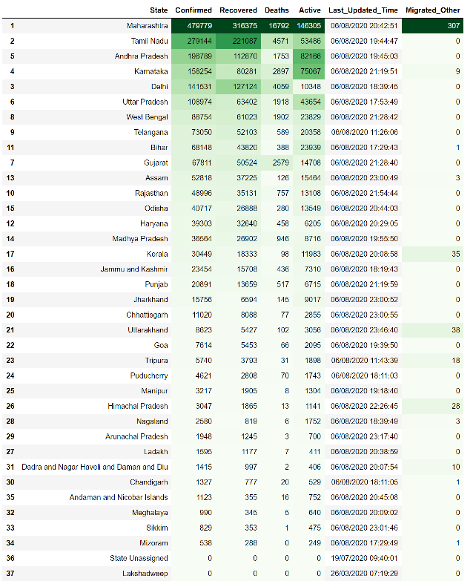
Summary

Slide 17
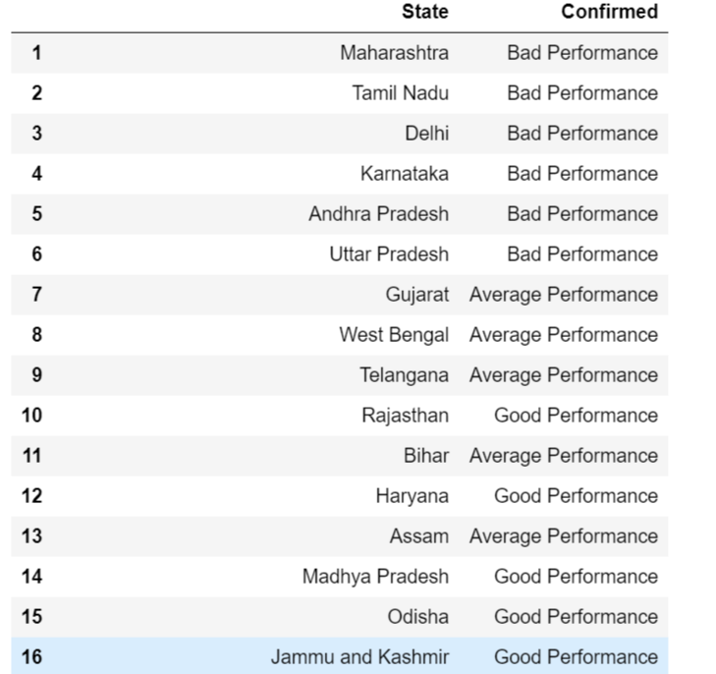
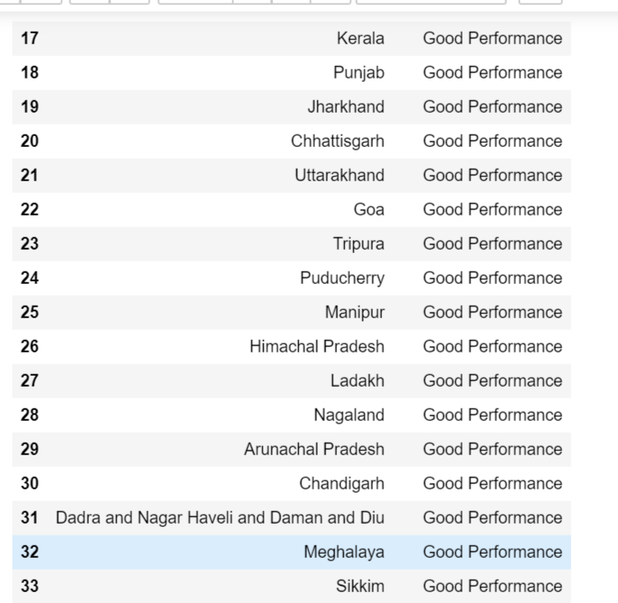
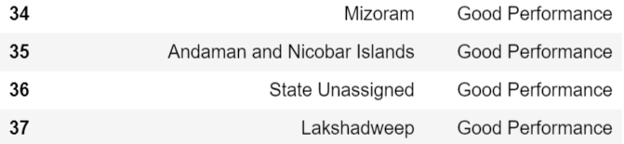
Performance of States

Slide 18
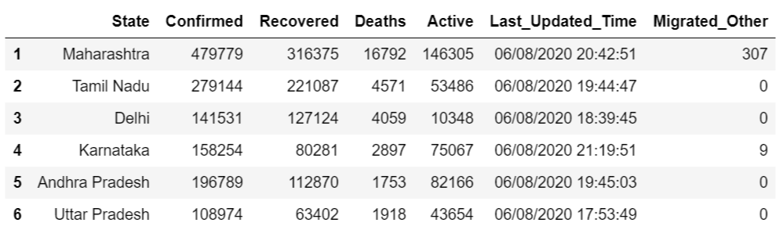
States with more than 100000 Confirmed Cases

Slide 19
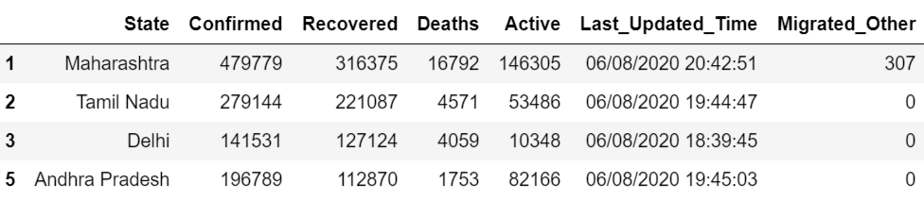
States with more than 100000 Recovered Patients

Slide 20
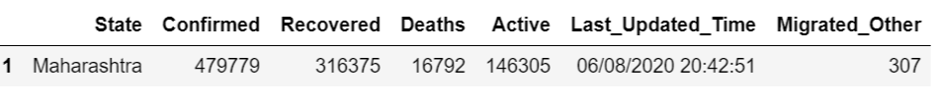
States with more than 10000 Covid19 Deaths

Slide 21

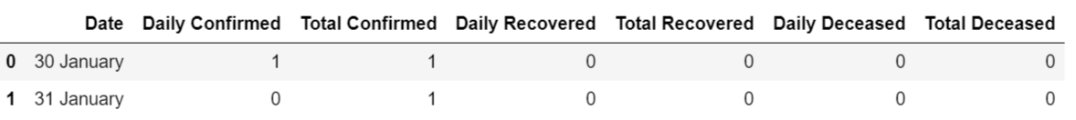
Month Wise Covid19 Cases.
Total Confirmed Covid19 Cases in the month of January
2
Since first Covid19 confirmed case in India is on 30th January 2020, there is only 2 confirmed Covid19 cases in the month of January.

Slide 22
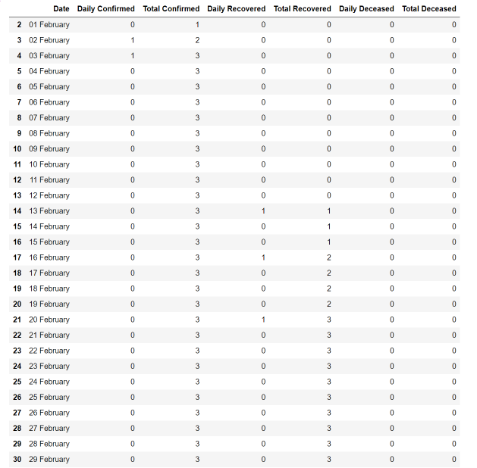
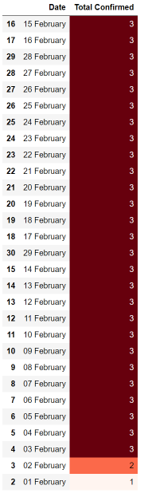
Total Confirmed Covid19 Cases in the month of February
84

Slide 23
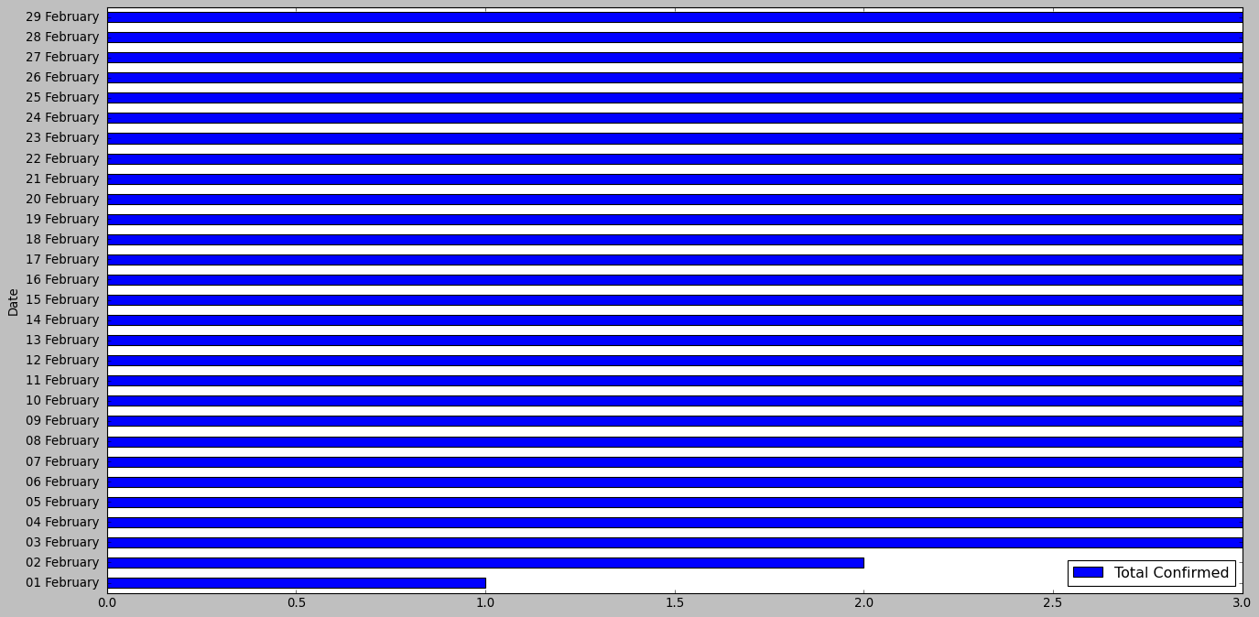

Slide 24
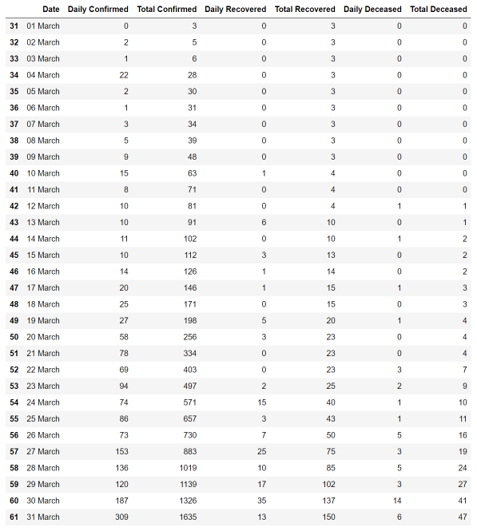
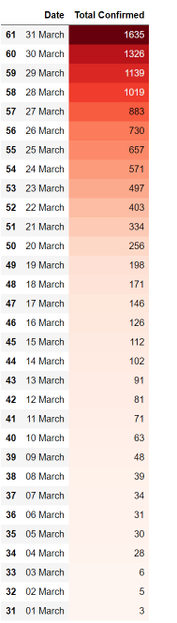
Total Confirmed Covid19 Cases in the month of March
10835

Slide 25
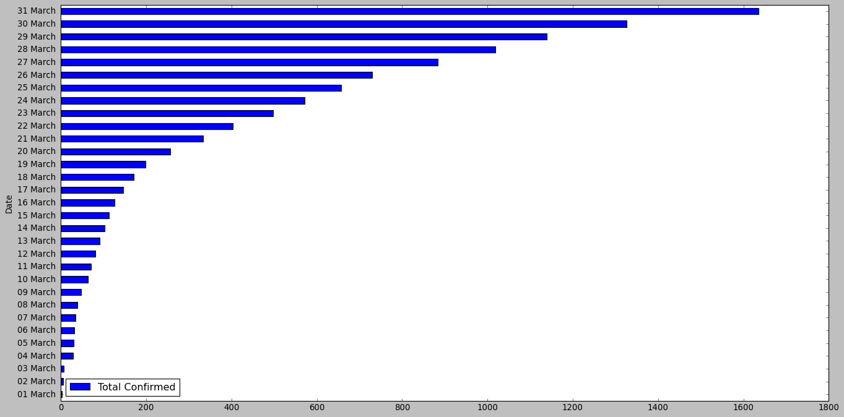

Slide 26
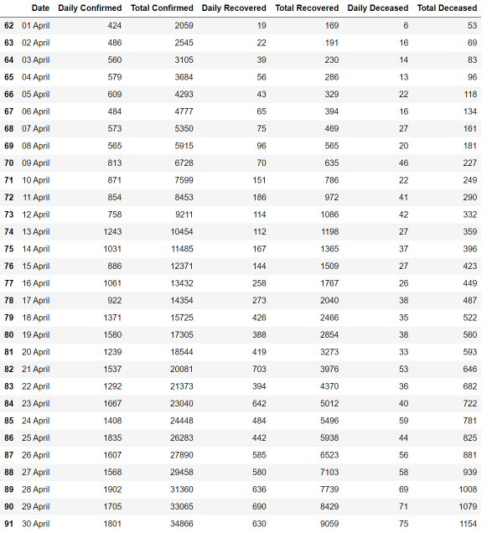
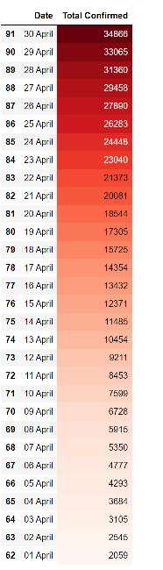
Total Confirmed Covid19 Cases in the month of April
449253

Slide 27
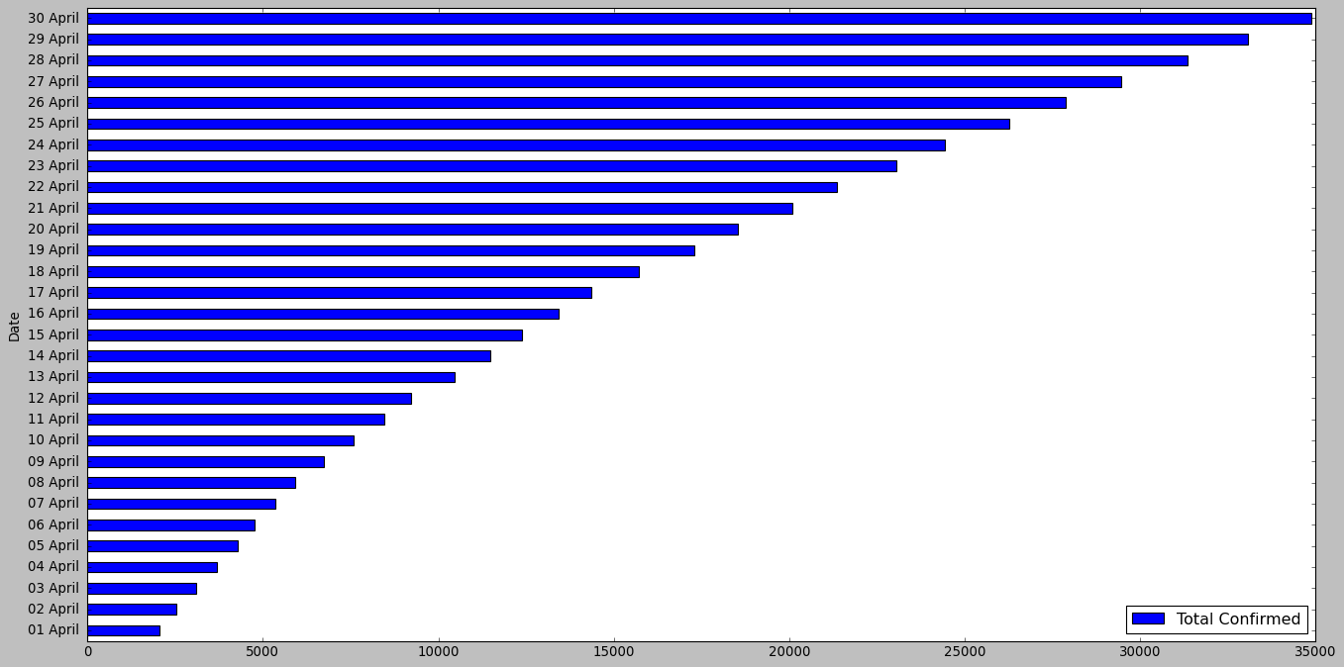

Slide 28
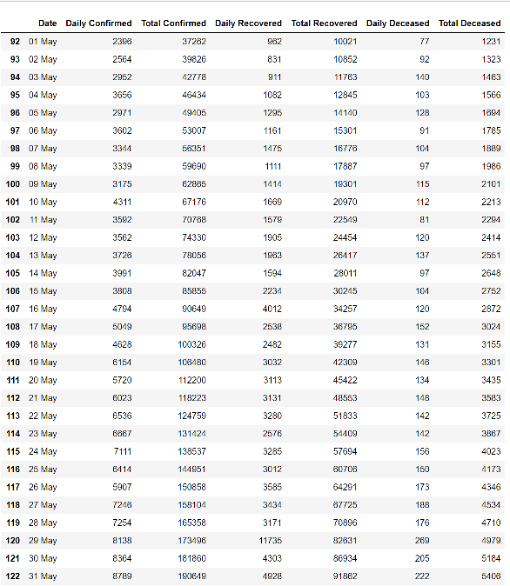
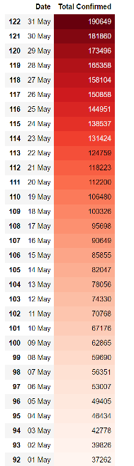
Total Confirmed Covid19 Cases in the month of May
3089422

Slide 29
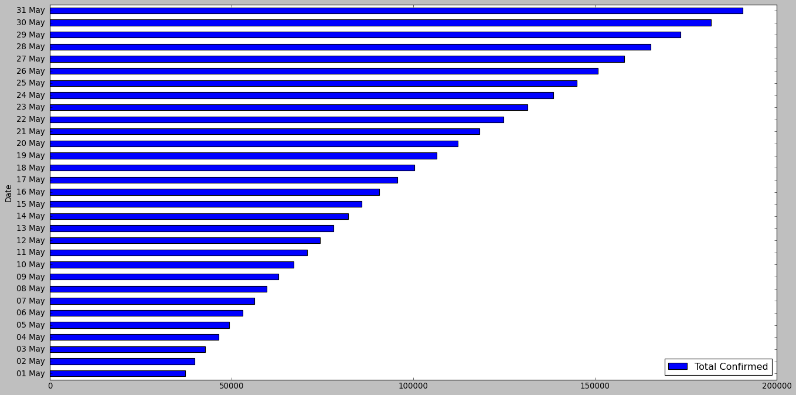

Slide 30
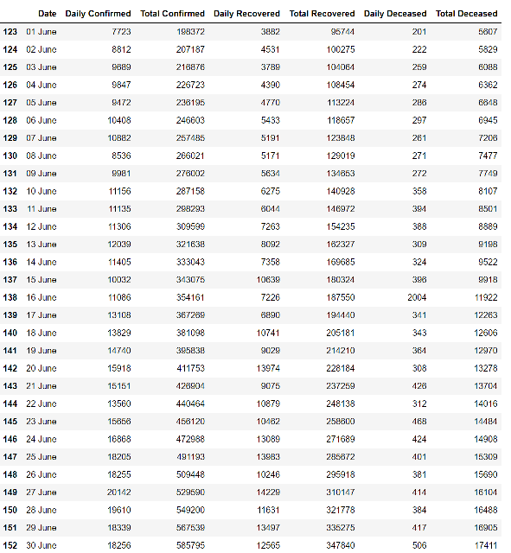
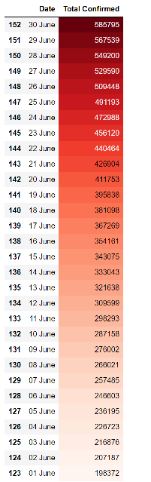
Total Confirmed Covid19 Cases in the month of June
10963630

Slide 31
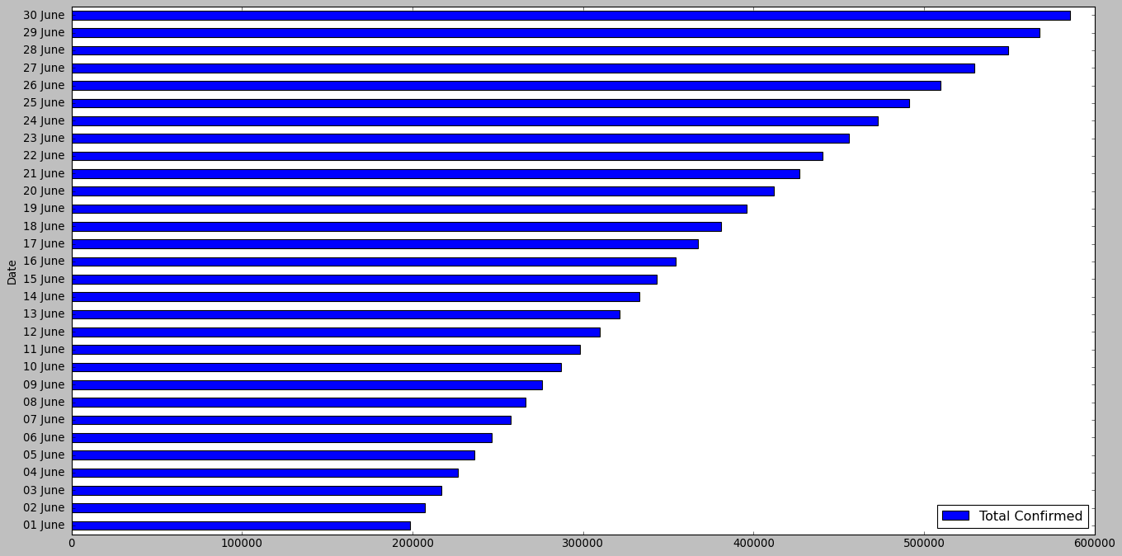

Slide 32
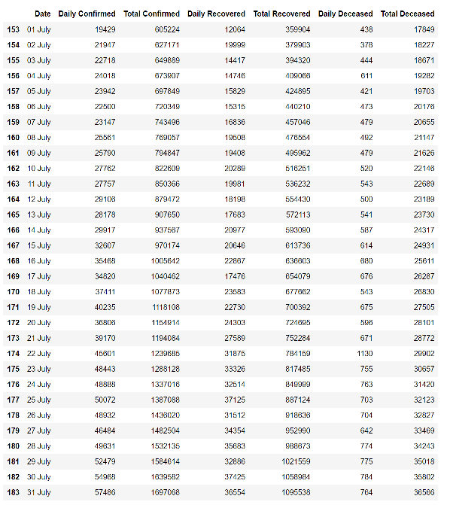
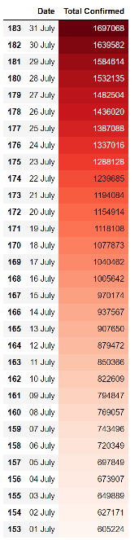
Total Confirmed Covid19 Cases in the month of July
32864550

Slide 33
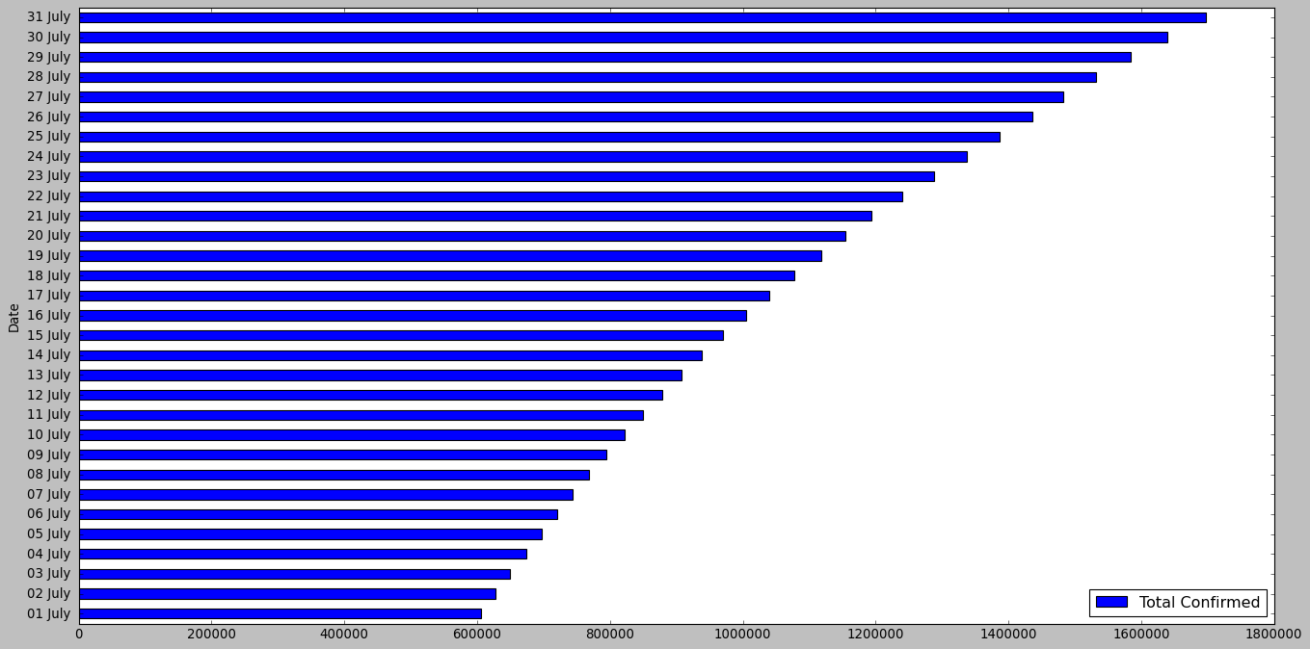

Slide 34
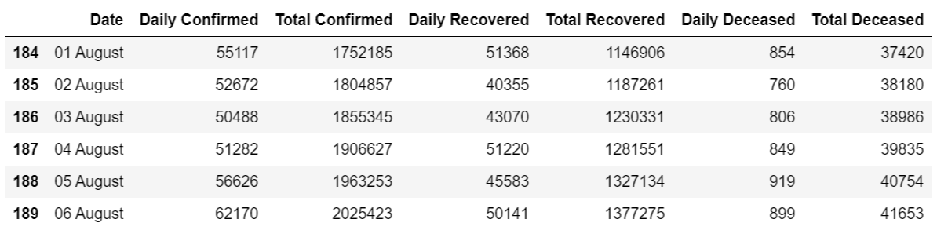
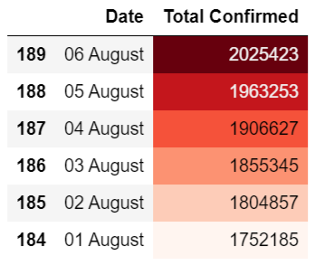
Total Confirmed Covid19 Cases in the month of August till 6 August 2020
11307690

Slide 35
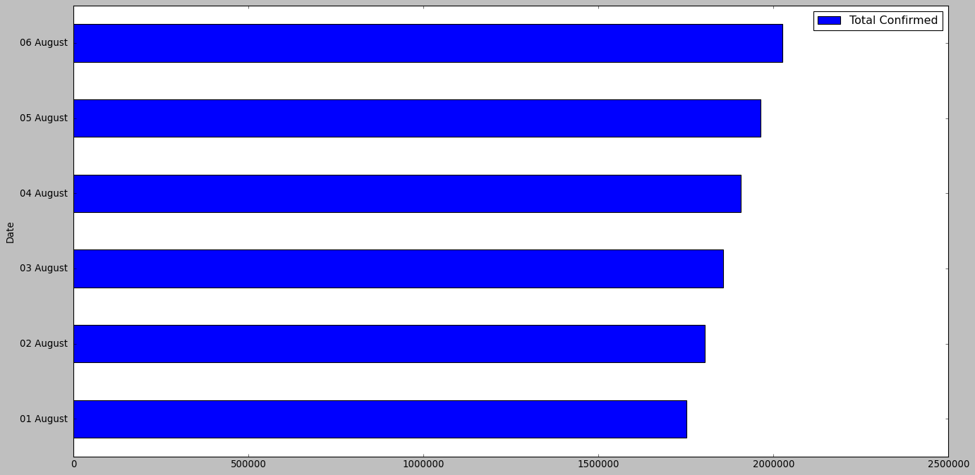

Slide 36
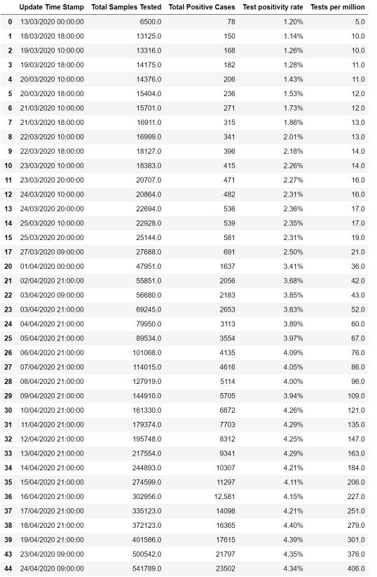
Covid19 Tests Day Wise.

Slide 37
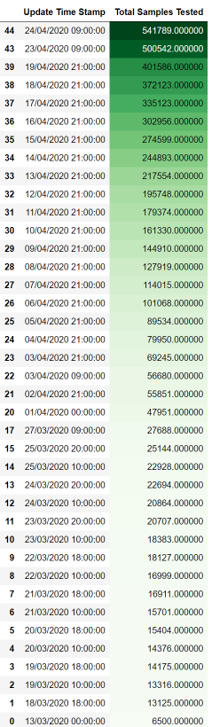
Highest number of Covid19 Samples Tested Dates

Slide 38
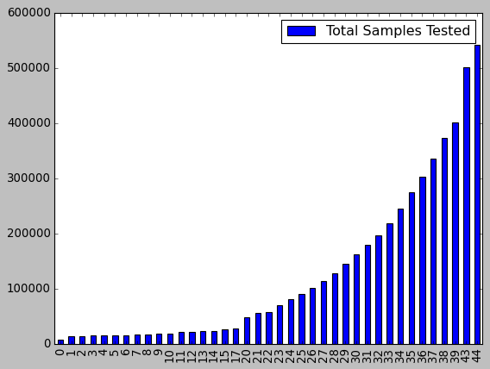

Slide 39
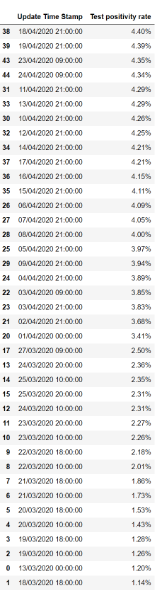
Highest Covid19 Test Positivity Rate Dates

Slide 40
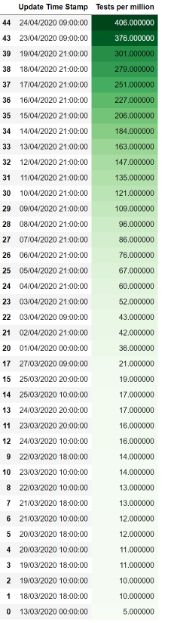
Highest Covid19 Tests Per Million Dates

Slide 41
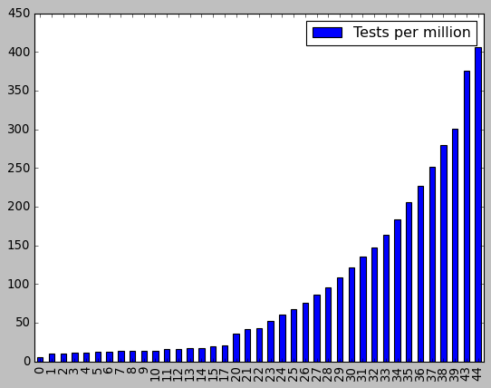

Slide 42
Everyday the number of Covid19 Positive Cases has been increased as the number of Covid19 tests increased.
In the month of March Covid19 Test Positivity Rate is 1.14% and in the month of April it has been increased to 4.40% due to increased testing.
The Covid19 Tests Per Million has also increased in the month of April compared to March.

Slide 43
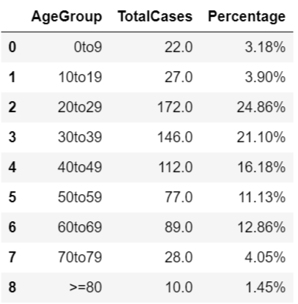
Different Age Groups People Affected By Covid19.

Slide 44
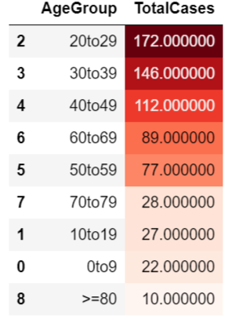
Age Groups with Highest Covid19 Cases

Slide 45
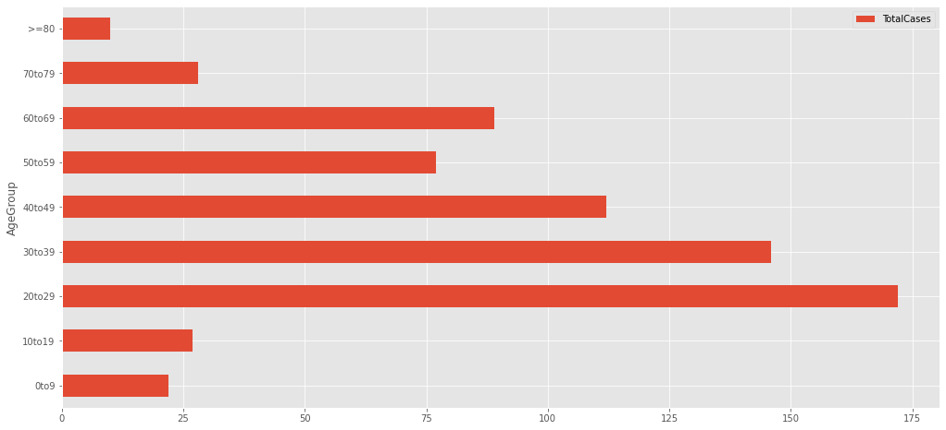

Slide 46

Age Groups with more than 100 Covid19 Cases

Slide 47

Age Groups with less than 50 Covid19 Cases

Slide 48

Hospital Beds In India.

Slide 49

States with highest Primary Health Centres
Total Primary Health Centres in India
29899

Slide 50


Slide 51

States with highest Community Health Centres
Total Community Health Centres in India
5568

Slide 52


Slide 53

States with highest Sub District Hospitals
Total Sub District Hospitals in India
1255

Slide 54


Slide 55

States with highest District Hospitals
Total District Hospitals in India
1003

Slide 56


Slide 57

States with highest Public Health Facilities
Total Public Health Facilities in India
37725

Slide 58


Slide 59

States with highest Rural Hospitals
Total Rural Hospitals in India
19810

Slide 60


Slide 61

States with highest Urban Hospitals
Total Urban Hospitals in India
3772

Slide 62


Slide 63

Total Hospitals

Slide 64



States with highest Total Number of Hospitals

Slide 65


